Slide 1
Substrate: A strongly-typed AMS generator framework
Rahul Kumar, Rohan Kumar

Slide 2

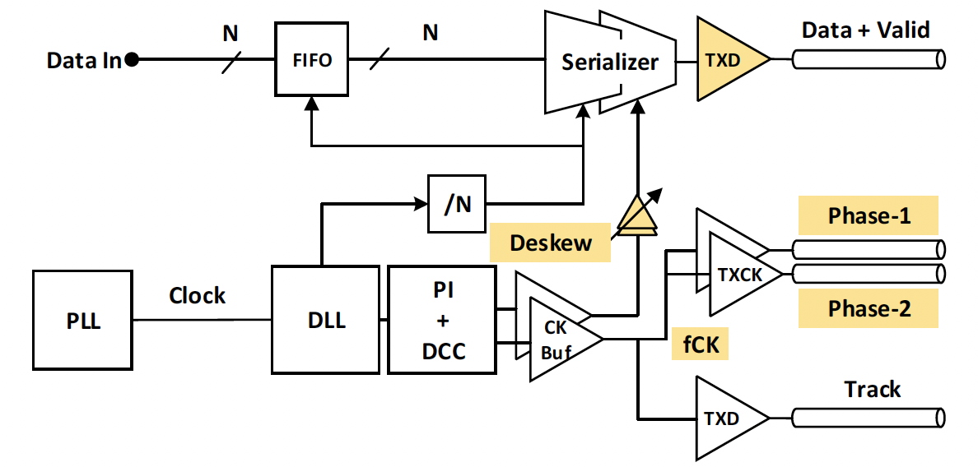
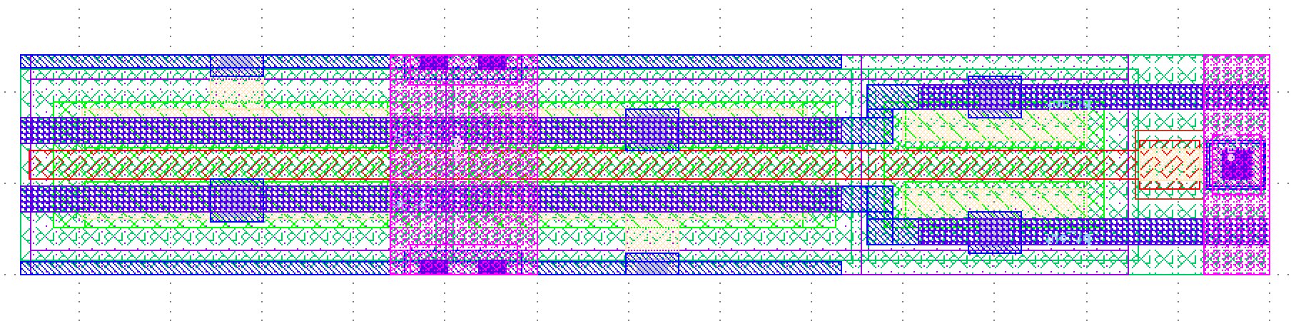
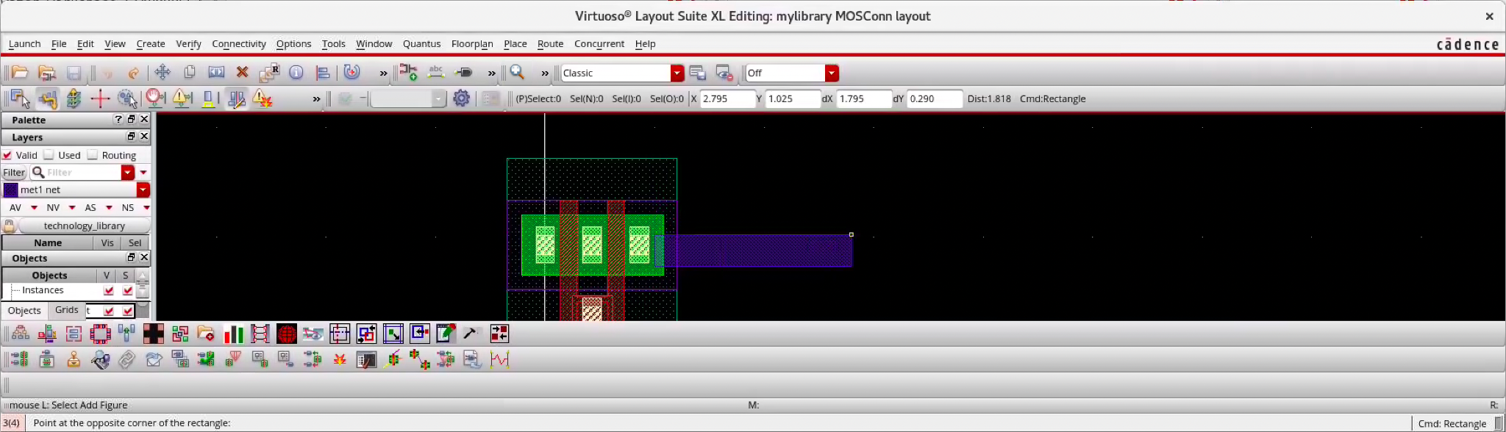
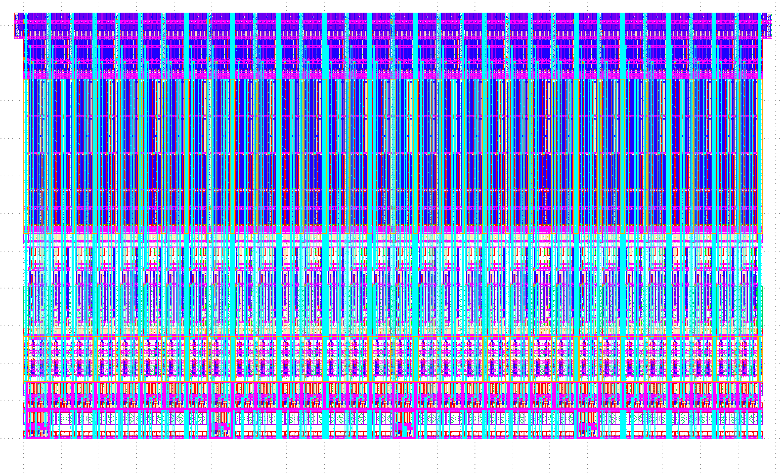
Making AMS circuits is tedious
All chips have mixed signal interfaces
Manual -> difficult to modify/reuse
Requires expertise in a variety of proprietary tools
Usually involves a complex GUI
Difficult to share designs

Slide 3
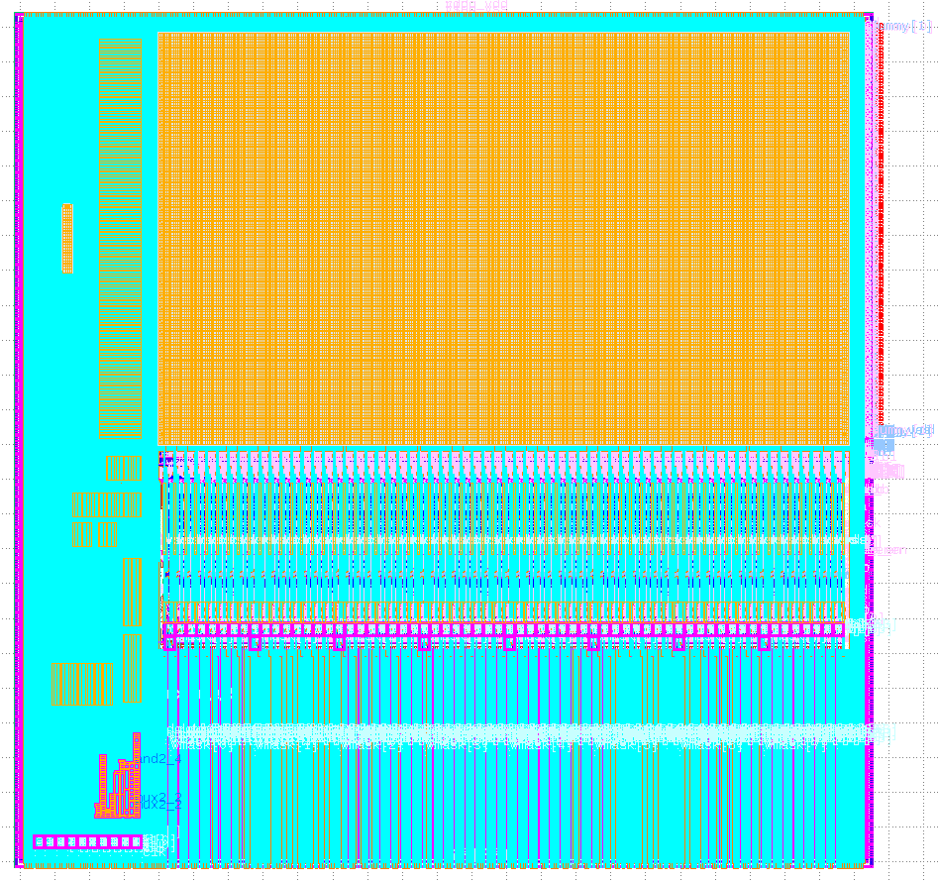
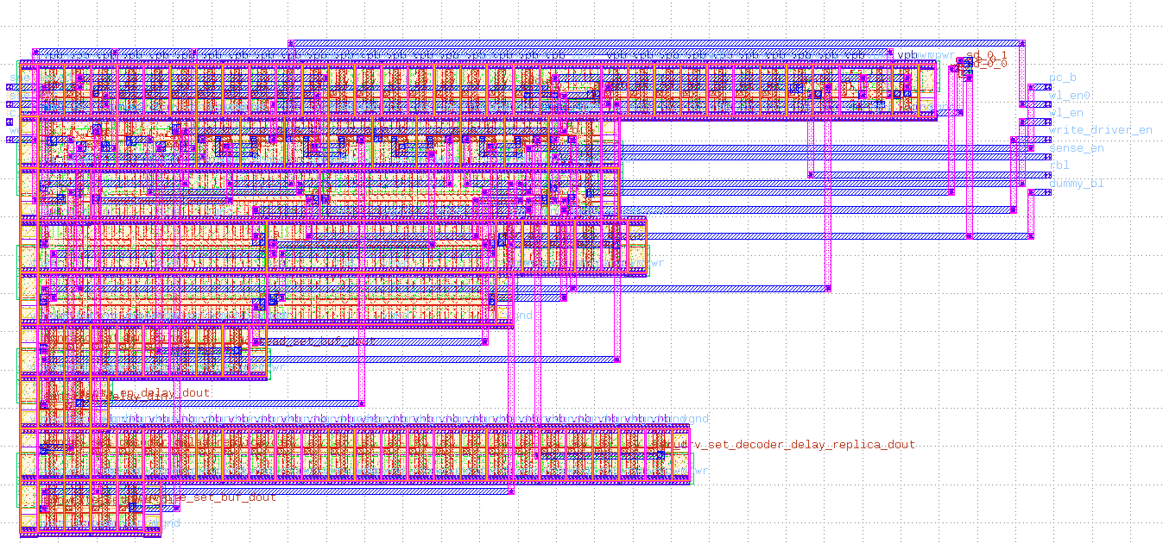
Substrate
Open-source framework for writing AMS generators in the Rust programming language
Supports parameterized netlist/layout generation and simulation
Used to generate SRAMs in SKY 130

Slide 4
Substrate design principles
Strong typing => better code
Correctness at compile time, code completion, clearer APIs
Methodology as a library
Substrate provides the primitives, can choose plugins to exercise those primitives as desired
Performance is flexibility
A high performance language gives you the freedom to write less performant code

Slide 5
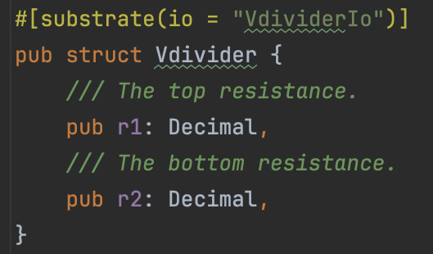
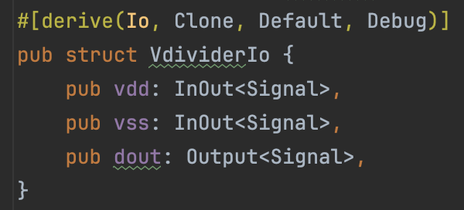
Blocks and IOs
Blocks are composable generator units
Each block has an associated IO (i.e. its ports)
Generator parameters and ports are encoded in the type system, allowing for automatic documentation and autocomplete

Slide 6
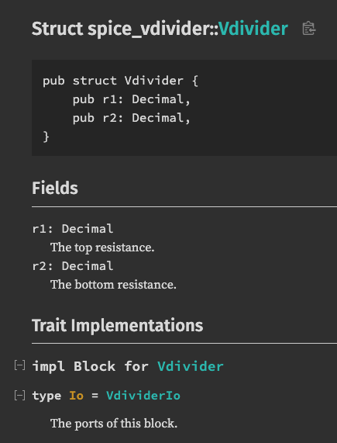
Blocks and IOs
Blocks are composable generator units
Each block has an associated IO (i.e. its ports)
Generator parameters and ports are encoded in the type system, allowing for automatic documentation and autocomplete

Slide 7
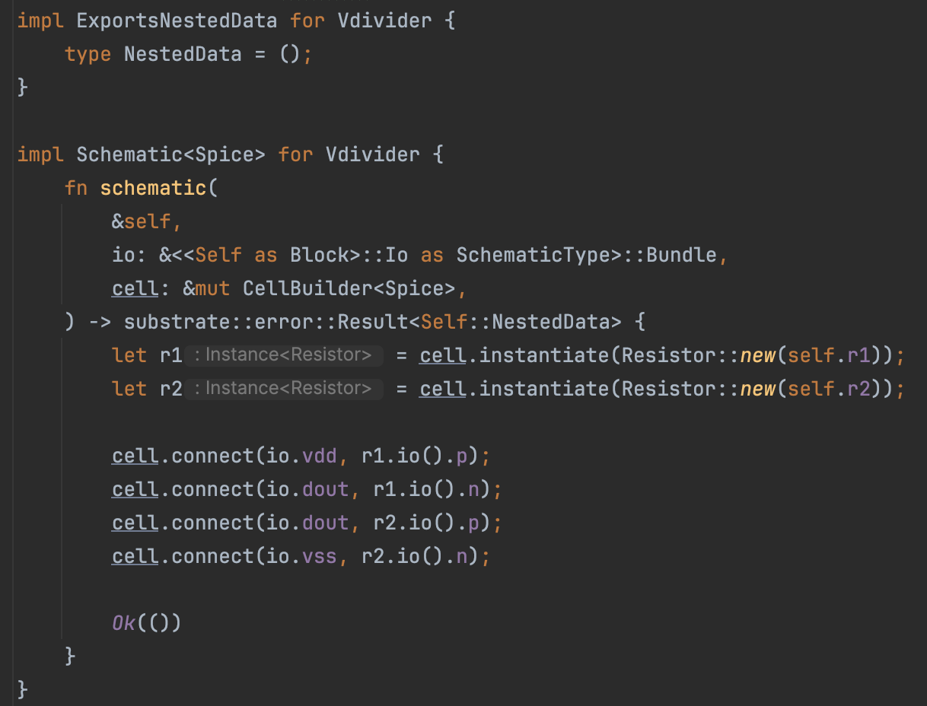
Schematics
Substrate allows you to define parametric schematic/netlist generators associated with a block

Slide 8
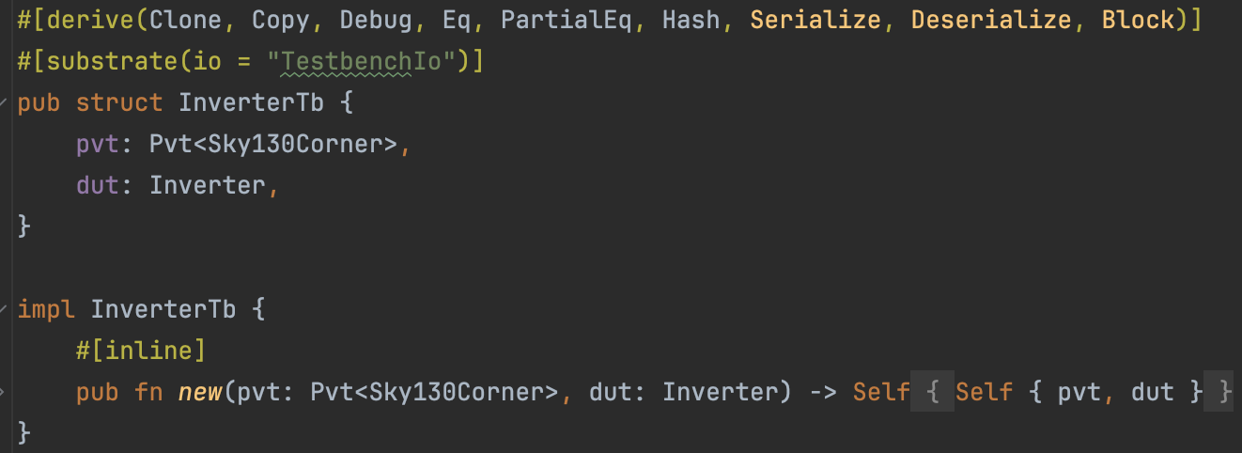
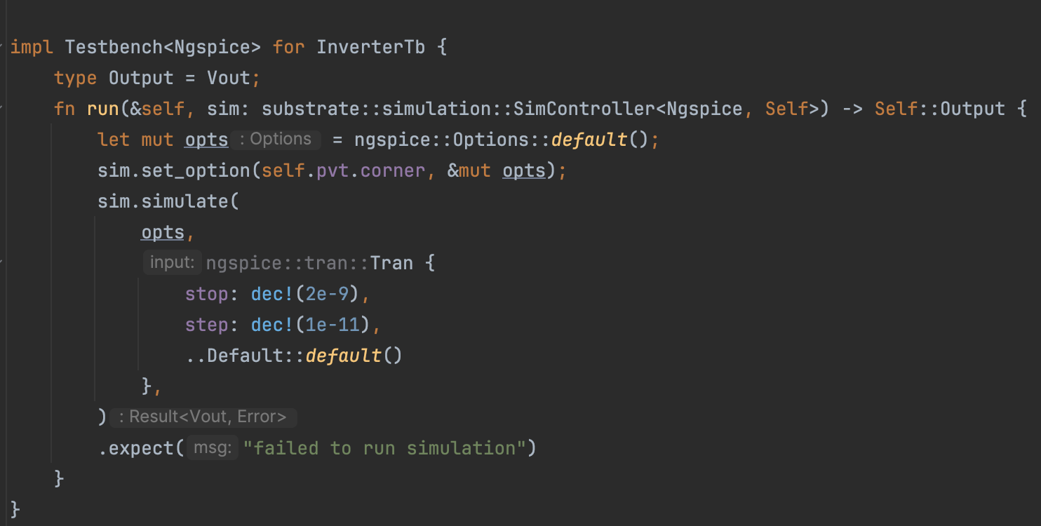
Simulation
Simulations are done by defining a testbench, then running the desired analyses

Slide 9
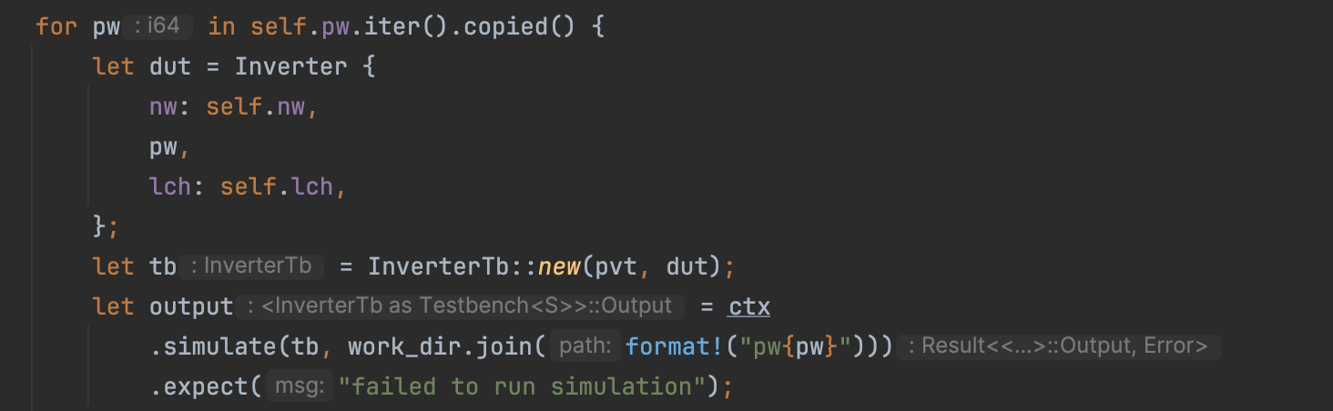
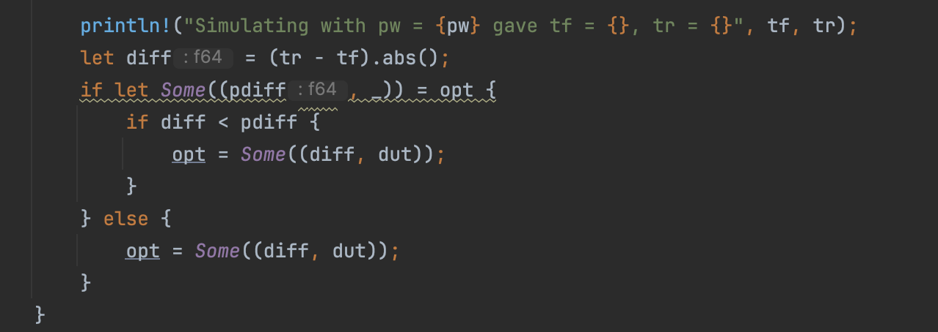
Closed-loop generators
Substrate allows you to use the results of a simulation to modify a design, or run additional simulations as needed

Slide 10
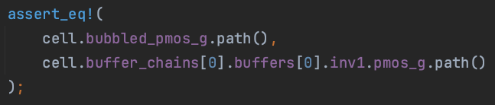
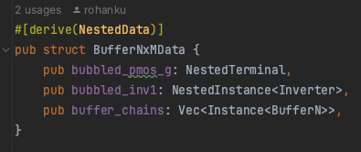
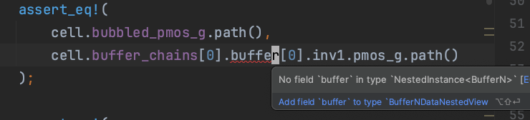
Node access API
Encode nested nodes and instances in the type system
Checks simulation node paths at compile time

Slide 11
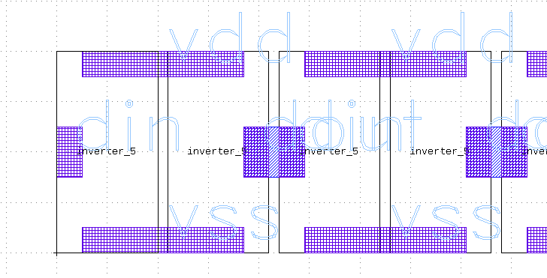
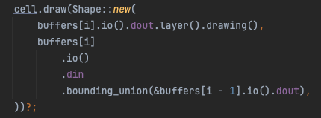
Layout
Flexible levels of layout abstraction:
Raw polygon pushing (effectively GDS)
Cells with exposed ports
Tileable cells with on-grid ports, enabling automatic routing
Enable user to trade off layout compactness with design time
Typed IOs make it easy to access pin geometry

Slide 12
Example layouts (SKY 130)

Slide 13
Standard cells
Place standard cells, jog off-grid ports to grid, declare port locations, and auto-route.

Slide 14
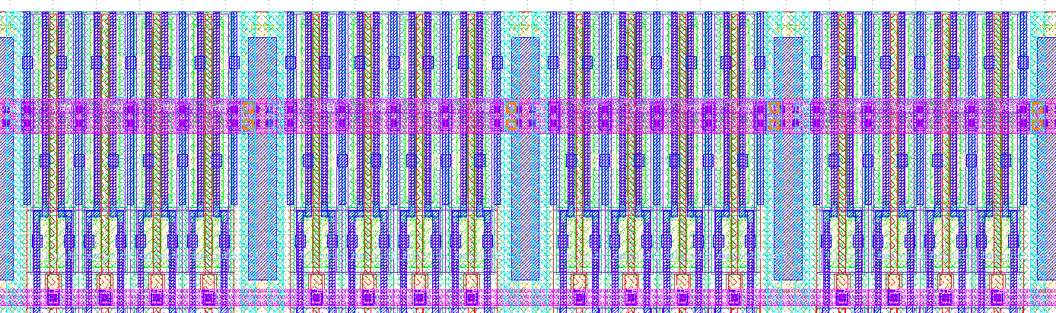
Pitch-constrained layout
Generate highly compact layout using track assignment APIs.

Slide 15
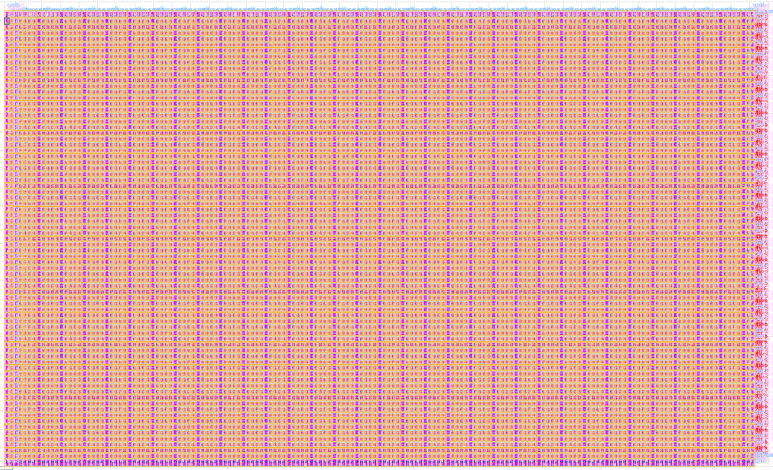
Tiled layout
Tile regular layout structures.

Slide 16
Automatic power straps
Place power straps in unused regions of the routing grid.

Slide 17
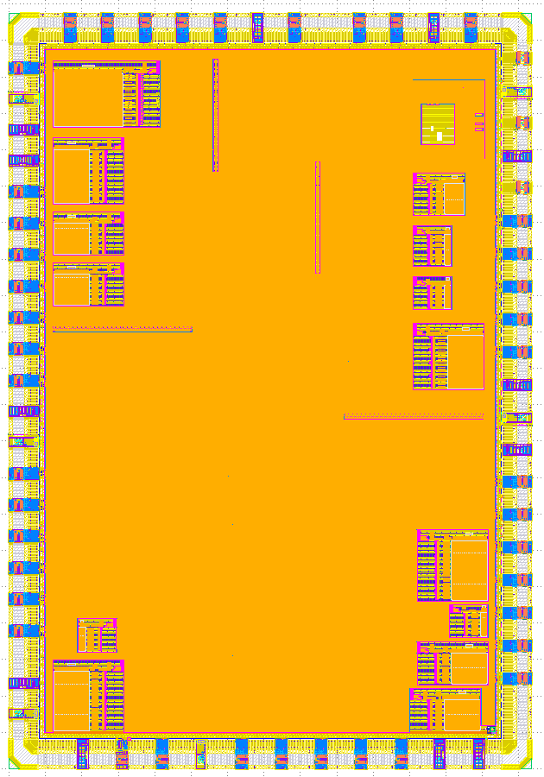
STAC
All of these layouts were taped out on the SRAM Timing Analysis Chip (STAC) in June 2023. Discussed in an earlier talk.

Slide 18
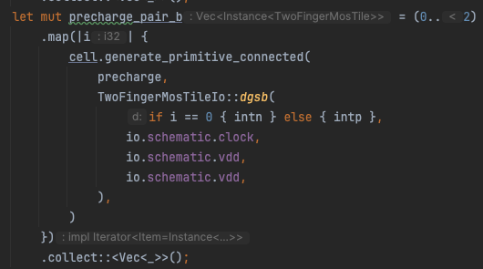
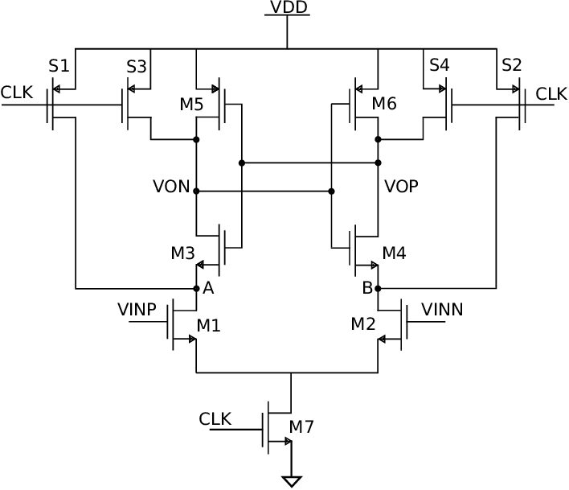
ATOLL
Automatic translation of logical layout — user defines layout and schematic simultaneously, then library automatically completes layout based on constraints.

Slide 19
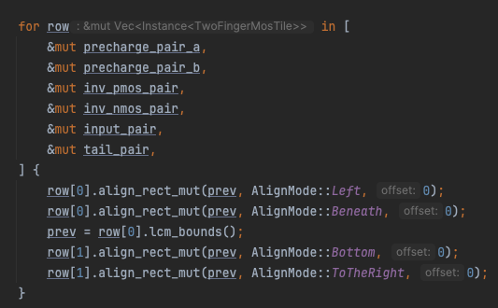
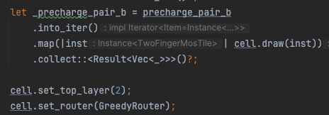
ATOLL
Automatic translation of logical layout — user defines layout and schematic simultaneously, then library automatically completes layout based on constraints.

Slide 20
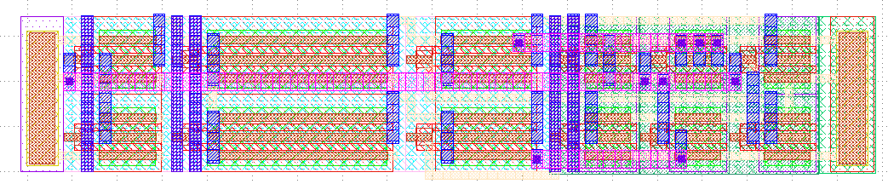
ATOLL
Automatic translation of logical layout — user defines layout and schematic simultaneously, then library automatically completes layout based on constraints.

Slide 21
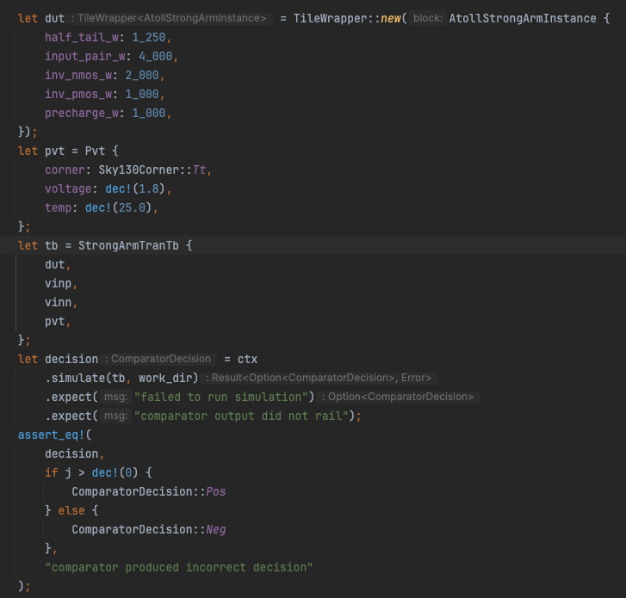
ATOLL
Since ATOLL cells include a schematic, can instantiate them in testbenches.

Slide 22
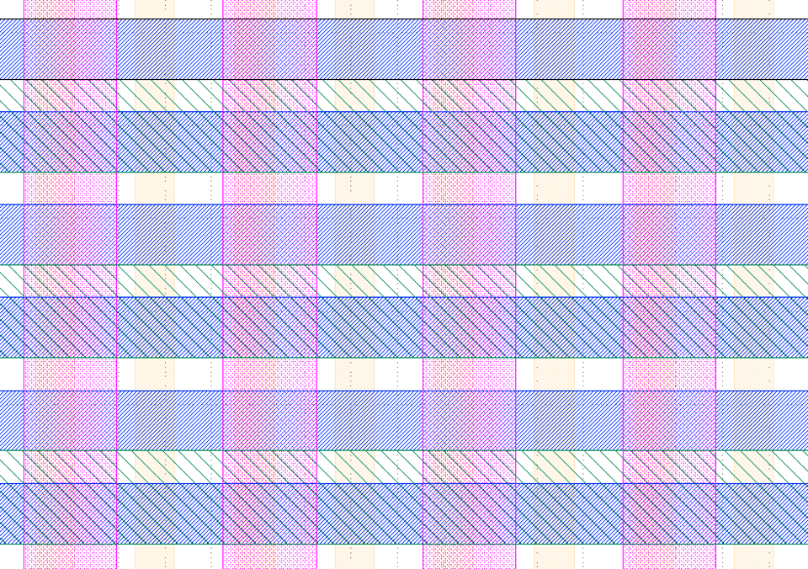
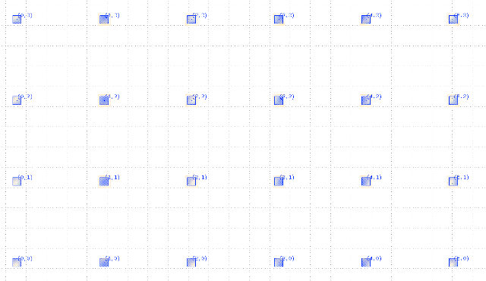
ATOLL
Imposes strict constraints on tiles to enable a global routing grid
Tile dimensions must be multiple of the LCM of track pitches on routing layers that it occupies
Guarantees that geometry will remain on grid, enabling simple top-level routing and tiling
Create tiles by using ATOLL to create an abstract view of a raw layout

Slide 23
Future work
Additional features
PEX simulation with node matching
Automatic LEF/LIB generation
FinFET layout
Improve existing APIs (e.g. ATOLL) to enable more complex generators
Plan to use Substrate to generate analog components of the Universal Chiplet Interconnect Express (UCIe) PHY
Support additional tools/libraries:
Layout methodologies
Simulators (currently supports Ngspice and Spectre) and analyses
PDKs (currently supports Sky 130 and Intel 16)

Slide 24
Conclusion
If you are interested in trying out Substrate:
Substrate is open source: https://github.com/ucb-substrate/substrate2
Some plugins (e.g. Spectre, Ngspice) are also open source
Comes with a few tutorials on schematics and simulation: https://docs.substratelabs.io/docs/category/getting-started
If you are interested in contributing, feel free to email us at rahulkumar@berkeley.edu and rohankumar@berkeley.edu

Slide 25
Citations
Kumar, R. (2023). A Composable Mixed-Signal Generator Framework with Applications to an SRAM Compiler (Issue UCB/EECS-2023-137) [Master’s Thesis, EECS Department, University of California, Berkeley]
Universal Chiplet Interconnect Express, Inc. (2023, July 10). Universal Chiplet Interconnect Express 1.1 Specification.
Kasap, Begum. (2018). Low-Noise Low-Power Floating Double-Tail Dynamic Latched Comparator Designs. 10.13140/RG.2.2.28298.82881/1.

